Slide 1

In Bound and Out Bound Marketing

Slide 2

What is Inbound Marketing
Inbound marketing is the practice of bringing warm, qualified leads into your sales funnel rather than reaching outward to cold targets.
Inbound marketing ways
SEO
Pay-Per-Click (PPC)
Social Media
Blogging
Inbound marketing focuses on creating and promoting Valuable content, your marketable content, building customer relationships, and overall "pulling" the customer toward you.

Slide 3
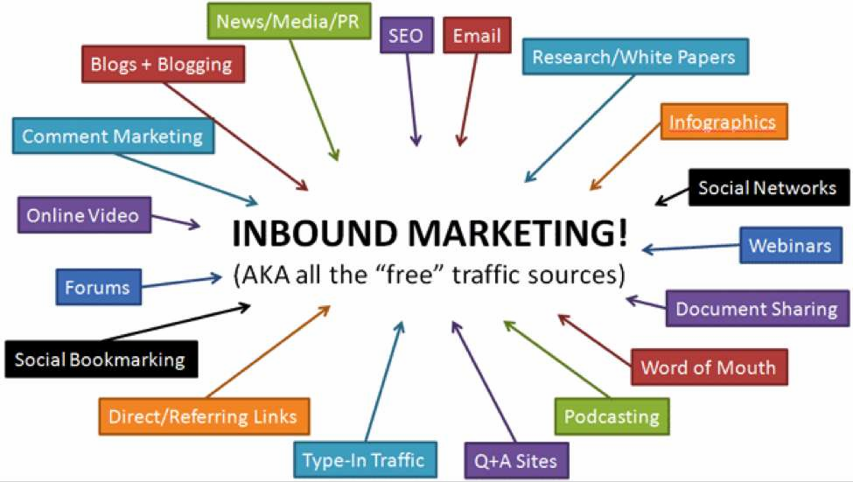
Inbound Marketing

Slide 4
In Bound Marketing
SEO Get higher ranking at SERP SEM
Without paying Paid
SMO Increase reachability of ideal user SMM
Without paying Paid
Messenger Get more business Email
Marketing with sending proposal Marketing

Slide 5

What is Outbound Marketing
Outbound Marketing,also known as traditional marketing, has been the main marketing strategy for the past century.
Outbound marketing ways
TV
Radio
Print
Telemarketing
Direct Mail
Tradeshows

Slide 6
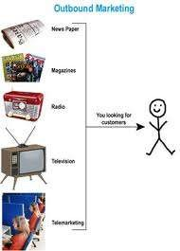

Slide 7
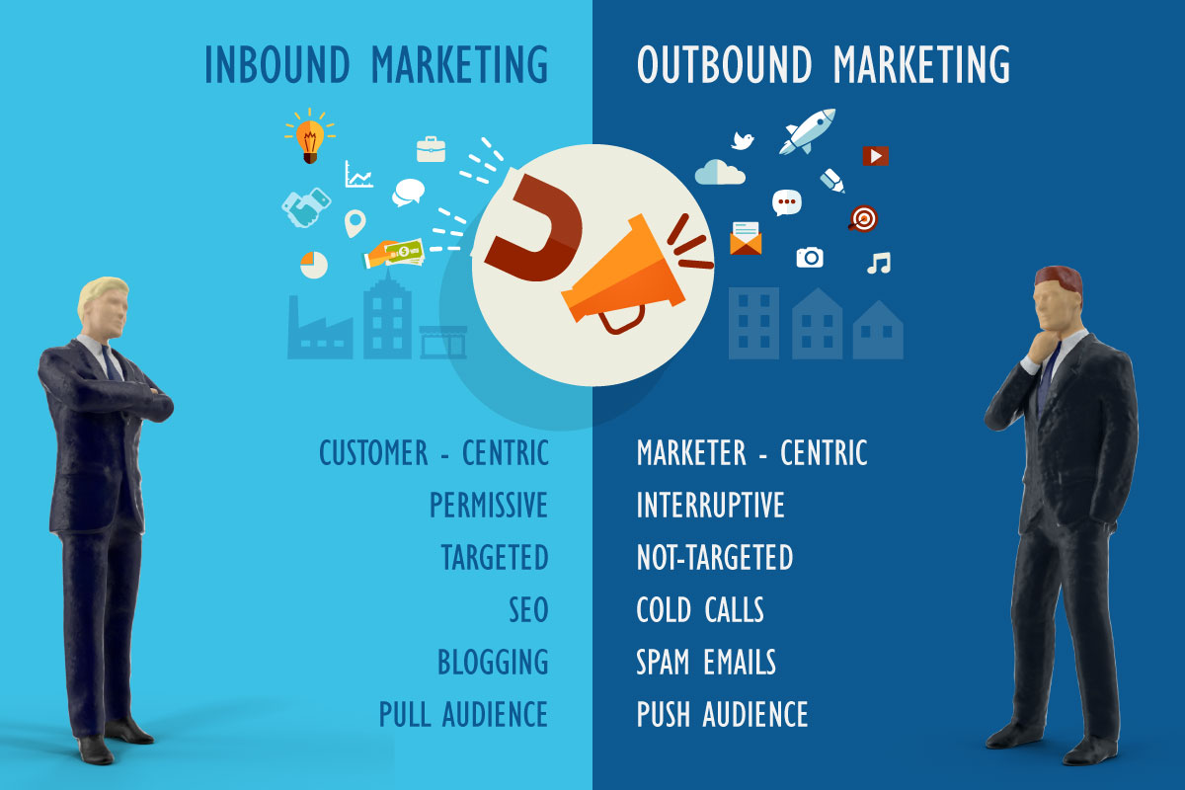
Inbound Vs Outbound

Slide 8
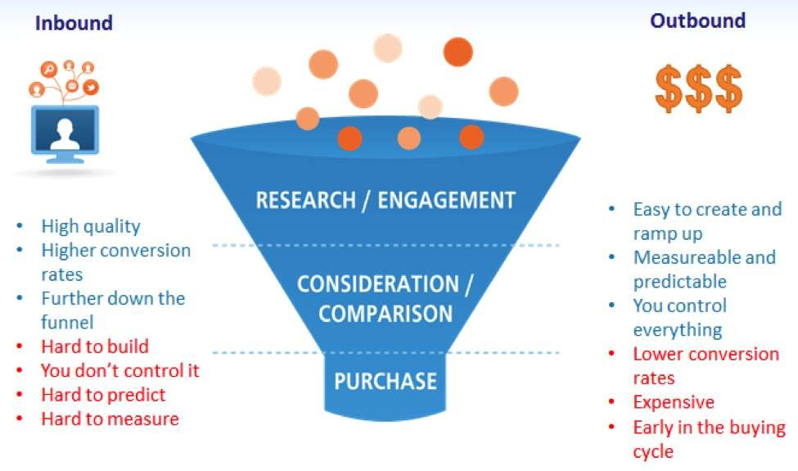

Slide 9
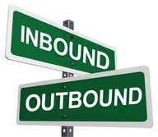
Inbound Vs. Outbound
Inbound Marketing needs to become part of you website and organization.
Outbound Marketing, since it is based on paid media, can be spun up much more quickly, you have a lot more control over the messaging and impressions, have a greater ability to test and tweak.
It takes time to build content, grow your social networks, increase website authority, acquire high quality, Prefer interesting research link

